Slide 1
ECE 554 TPUv1 Miniproject
University of Wisconsin – Madison
Spring 2021

Slide 2
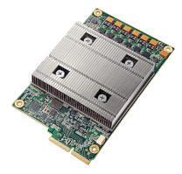
Google’s TPUv1
“Skunkworks” project started at Google’s lab in Madison, WI
Driven by need for energy-efficiency for running ML inference workloads
2013 “Hey Google” scenario: every Android user speaks for 3 minutes/day. Deploying speech recognition on datacenter CPUs (Intel Xeon) would require doubling or tripling # of Google datacenters (already massive).
Concept to deployment 15 months (in datacenters at scale in 2015)
Led to 80x performance/Watt improvement over CPU deployment
Applicable to wide range of Deep Neural Network tasks beyond speech
Search page rank, Youtube recommendations, image classification, etc.
More: In-Data Center Performance Analysis of a Tensor Processing Unit, ISCA 2017, Jouppi, Young, Patil, Patterson, et al.

Slide 3
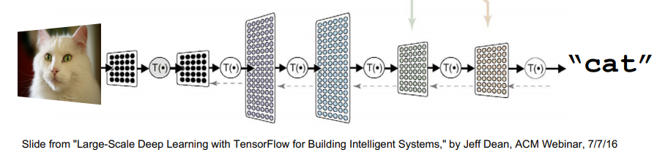
TPUv1 Secret Sauce
Application-specific IC (ASIC): matrix multiplication for DNN
Remove all general-purpose functionality
Just 5 CISC instructions: ReadHostMem, WriteHostMem, ReadWeights, MatrixMultiply, Activate
Choose minimal sufficient data type: 8b fixed point
Vanhoucke, V., Senior, A. and Mao, M.Z., 2011, December. Improving the speed of neural networks on CPUs. In Proc. Deep Learning and Unsupervised Feature Learning NIPS Workshop (Vol. 1, p. 4).

Slide 4
Blocked/Tiled Matrix Multiply
X
=
A
B
C
for i=1,n # rows
for j=1,n # columns
for k=1,n # dot product
C[i,j] += A[i,k] * B[k,j];
for i=1,n by 256 # block rows
for j=1,n by 256 # block columns
for k=1,n by 256 # block dot product
for ii=i,(i+255) # 256x256 rows
for jj=j,(j+255) # 256x256 columns
for kk=k,(k+255) # 256x256 dot product
C[ii,jj] += A[ii,kk] * B[kk,jj];
For large n, no reuse in on-chip memory
100% miss rate for B,C
A has spatial locality
A miss rate is BS/8
Can we do better?
TPUv1
Blocks sized to fit in on-chip memory
e.g. 256KB D$: 64KB for A & B, 128KB for C
64KB/1B = 256x256 subarray of A,B
128KB/2B = 256x256 subarray of C (16b each)
Full reuse for C (output stationary)
A,B reused within block

Slide 5
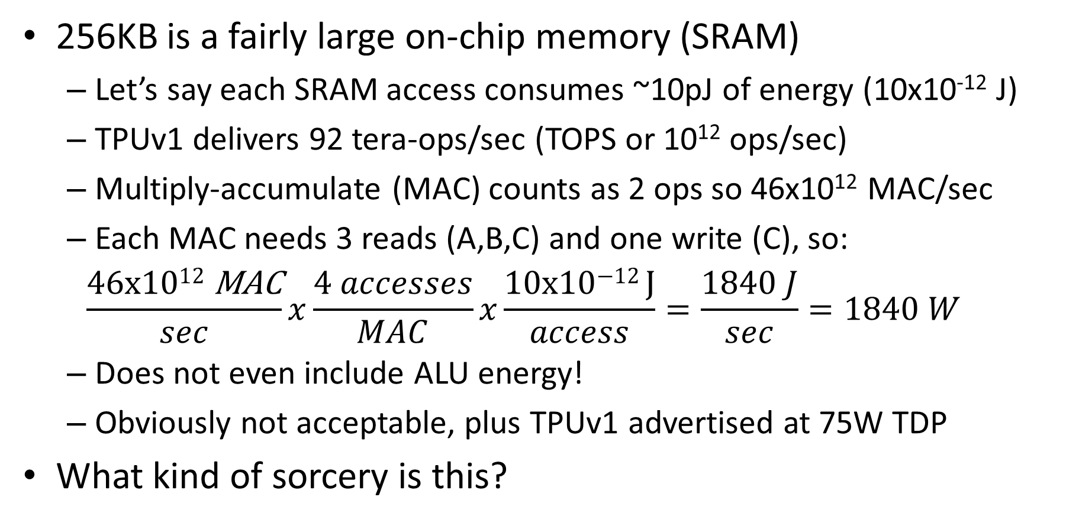
More secret sauce
256KB is a fairly large on-chip memory (SRAM)
Let’s say each SRAM access consumes ~10pJ of energy (10x10⁻¹² J)
TPUv1 delivers 92 tera-ops/sec (TOPS or 10¹² ops/sec)
Multiply-accumulate (MAC) counts as 2 ops so 46x10¹² MAC/sec
Each MAC needs 3 reads (A,B,C) and one write (C), so:
$$\frac{\text{46}\text{x}\text{1012 }\text{MAC}}{sec}x\frac{4 accesses}{MAC}x\frac{\text{10}\text{x}\text{10−12 }\text{J}}{access}=\frac{1840 J}{sec}=1840 W$$
Does not even include ALU energy!
Obviously not acceptable, plus TPUv1 advertised at 75W TDP
What kind of sorcery is this?
➔ A Systolic Array⬅

Slide 6
Systolic Arrays
B
Proposed in the 1980s
H.T. Kung, CMU WARP project
Intel iWarp – commercial failure
The idea faded away
ALUs organized as 2d array
Operands read once, then pulse (hence, systolic) through array
Minimizes energy for operand delivery
Here, A & B enter diagonally and accumulate at entries of C
Numerous ways to organize data flow
Not clear what Google TPUv1 does
This is what we will do in the miniproject
A
Elements of A
MAC units
C is stationary
Elements of B

Slide 7
8x8 Systolic Matrix Multiply
a00 a01 a02 a03 a04 a05 a06 a07
a10 a11 a12 a13 a14 a15 a16 a17
a20 a21 a22 a23 a24 a25 a27 a27
a30 a31 a32 a33 a34 a35 a36 a37
a40 a41 a42 a43 a44 a45 a46 a47
a50 a51 a52 a53 a54 a55 a56 a57
a60 a61 a62 a63 a64 a65 a66 a67
a70 a71 a72 a73 a74 a75 a76 a77
b00 b01 b02 b03 b04 b05 b06 b07
b10 b11 b12 b13 b14 b15 b16 b17
b20 b21 b22 b23 b24 b25 b27 b27
b30 b31 b32 b33 b34 b35 b36 b37
b40 b41 b42 b43 b44 b45 b46 b47
b50 b51 b52 b53 b54 b55 b56 b57
b60 b61 b62 b63 b64 b65 b66 b67
b70 b71 b72 b73 b74 b75 b76 b77
c00 c01 c02 c03 c04 c05 c06 c07
c10 c11 c12 c13 c14 c15 c16 c17
c20 c21 c22 c23 c24 c25 c27 c27
c30 c31 c32 c33 c34 c35 c36 c37
c40 c41 c42 c43 c44 c45 c46 c47
c50 c51 c52 c53 c54 c55 c56 c57
c60 c61 c62 c63 c64 c65 c66 c67
c70 c71 c72 c73 c74 c75 c76 c77
b77
b67
b57
b47
b37
b27
b17
b07
Bin[7:0]
Minilab 2
b71
b61
b51
b41
b31
b21
b11
b01
8b Reg
b70
b60
b50
b40
b30
b20
b10
b00
Ain[7:0]
Aout[7:0]
…
CCIP interface
8x8 Mult
a07
a06
a05
a04
a03
a02
a01
a00
en
16b Adder
a17
a16
a15
a14
a13
a12
a11
a10
MAC
MAC
…
MAC
c00
c01
c07
Cin[15:0]
WrEn
…
MAC
MAC
MAC
a77
a76
a75
a74
a73
a72
a71
a70
c10
c11
c17
8b Reg
16b Reg (cxx)
…
…
…
…
Added en in v1.1
…
MAC
MAC
MAC
c70
c71
c77
Bout[7:0]
Cout[15:0]

Slide 8
Minilab 2
module tpumac
#(parameter BITS_AB=8,
parameter BITS_C=16)
(
input clk, rst_n, WrEn, en,
input signed [BITS_AB-1:0] Ain,
input signed [BITS_AB-1:0] Bin,
input signed [BITS_C-1:0] Cin,
output reg signed [BITS_AB-1:0] Aout,
output reg signed [BITS_AB-1:0] Bout,
output reg signed [BITS_C-1:0] Cout
);
// NOTE: added register enable in v1.1
// Also, Modelsim prefers “reg signed” over “signed reg”
Design the MAC unit for tpuv1
Note Aout/Bout/Cout only update if en set
Write a self-checking testbench
Submit to Canvas dropbox
tpumac.sv, tpumac_tb.sv, results from tb
~2 page nicely formatted report that explains your testbench approach, implementation, results, and your assessment of coverage
No synthesis or fpga test for this minilab
Due Tue Feb. 2 at midnight

Slide 9
Looking ahead
a00 a01 a02 a03 a04 a05 a06 a07
a10 a11 a12 a13 a14 a15 a16 a17
a20 a21 a22 a23 a24 a25 a27 a27
a30 a31 a32 a33 a34 a35 a36 a37
a40 a41 a42 a43 a44 a45 a46 a47
a50 a51 a52 a53 a54 a55 a56 a57
a60 a61 a62 a63 a64 a65 a66 a67
a70 a71 a72 a73 a74 a75 a76 a77
b00 b01 b02 b03 b04 b05 b06 b07
b10 b11 b12 b13 b14 b15 b16 b17
b20 b21 b22 b23 b24 b25 b27 b27
b30 b31 b32 b33 b34 b35 b36 b37
b40 b41 b42 b43 b44 b45 b46 b47
b50 b51 b52 b53 b54 b55 b56 b57
b60 b61 b62 b63 b64 b65 b66 b67
b70 b71 b72 b73 b74 b75 b76 b77
c00 c01 c02 c03 c04 c05 c06 c07
c10 c11 c12 c13 c14 c15 c16 c17
c20 c21 c22 c23 c24 c25 c27 c27
c30 c31 c32 c33 c34 c35 c36 c37
c40 c41 c42 c43 c44 c45 c46 c47
c50 c51 c52 c53 c54 c55 c56 c57
c60 c61 c62 c63 c64 c65 c66 c67
c70 c71 c72 c73 c74 c75 c76 c77
b77
b67
b57
b47
b37
b27
b17
b07
b71
b61
b51
b41
b31
b21
b11
b01
Minilab 2: TPU MAC Unit
b70
b60
b50
b40
b30
b20
b10
b00
…
Minilab 3: Systolic Array
CCIP interface
Minilab 4: Memory/FIFOs for A,B,C
a07
a06
a05
a04
a03
a02
a01
a00
Minilab 5: CCIP Interface, control unit
Minilab 6: Integrate, software, fpga demo
a17
a16
a15
a14
a13
a12
a11
a10
MAC
MAC
…
MAC
c00
c01
c07
…
MAC
MAC
MAC
a77
a76
a75
a74
a73
a72
a71
a70
c10
c11
c17
…
…
…
…
…
MAC
MAC
MAC
c70
c71
c77

Slide 10
Questions?

